Slide 1
Angular
Heroes Tutorial

Slide 2
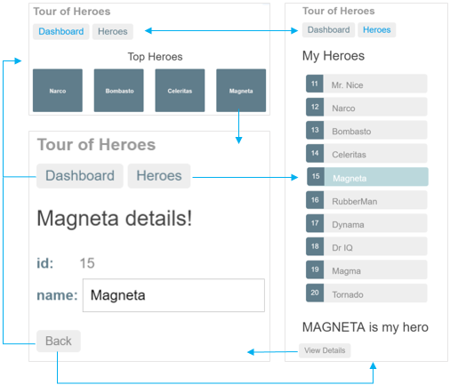
Heroes to-do
Θα δημιουργήσουμε το παρακάτω web app:

Slide 4
Χρήση
Angular local setup
https://angular.io/guide/setup-local
For Visual Studio Code:
https://medium.com/@Zeroesandones/how-to-create-a-shell-angular-9-project-5b5b254b3ac4
Online IDE https://stackblitz.com/
(no local installation)

Slide 5
Δημιουργία angular project
Online
https://stackblitz.com/
src/app folder includes Angular app

Slide 6
Index.html
<!doctype html>
<html lang="en">
<head>
<meta charset="utf-8">
<title>AngularTourOfHeroes</title>
</head>
<body>
<app-root></app-root>
</body>

Slide 7
App Component Structure
You'll find the implementation of the shell distributed over three files:
app.component.ts
the component class code, written in TypeScript.
app.component.html
the component template, written in HTML.
app.component.css
the component's private CSS styles.

Slide 8
Class file
Open the component class file (app.component.ts) and change the value of the title property to 'Tour of Heroes’.
app.component.ts (class title property)
Προσέξτε ότι: selector: 'app-root’
βάλτε στη κλάση:
title = 'Tour of Heroes';

Slide 9
Διπλά άγκιστρα
app.component.html (template) <h1>{{title}}</h1>
The double curly braces are Angular's interpolation binding syntax. This interpolation binding presents the component's title property value inside the HTML header tag.

Slide 10
src/styles.css
h1 { color: #369; font-family: Arial, Helvetica, sans-serif; font-size: 250%; }
h2, h3 { color: #444; font-family: Arial, Helvetica, sans-serif; font-weight: lighter; }
body { margin: 2em; }
body, input[type="text"], button { color: #333; font-family: Cambria, Georgia; }
* { font-family: Arial, Helvetica, sans-serif; }

Slide 11
Ως εδώ..
You learned that Angular components display data.
You used the double curly braces of interpolation to display the app title.

Slide 12
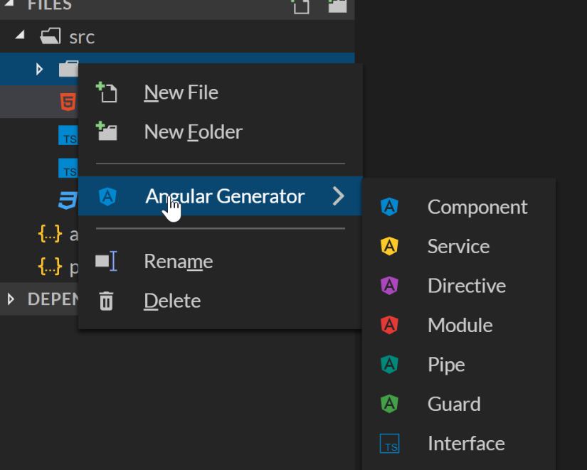
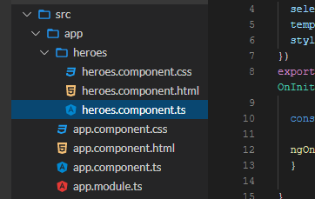
ng generate component heroes
Δεξί κλικ δημιουργία component
The CLI creates a new folder, src/app/heroes/,
3 files HeroesComponent

Slide 13
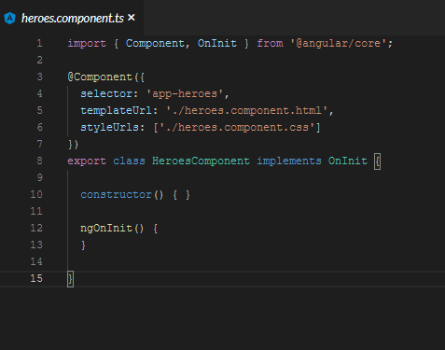
Component
Always import the Component symbol from the Angular core library and annotate the component class with @Component.
@Component is a decorator function that specifies the Angular metadata for the component.
The CLI generated three metadata properties:
selector— the component's CSS element selector
templateUrl— the location of the component's template file.
styleUrls— the location of the component's private CSS styles.

Slide 14
Component
The CSS element selector, 'app-heroes', matches the name of the HTML element that identifies this component within a parent component's template.

Slide 15
export
The ngOnInit() is a lifecycle hook.
Angular calls ngOnInit() shortly after creating a component.
It's a good place to put initialization logic.

Slide 16
import
Always export the component class so you can import it elsewhere ... like in the AppModule.

Slide 17
import
heroes.component.ts (hero property)
hero = 'Windstorm';
heroes.component.html
{{hero}}

Slide 18
Εμφάνιση του HeroesComponent
To display the HeroesComponent, you must add it to the template of the shell AppComponent.
Remember that app-heroes is the element selector for the HeroesComponent.
So add an <app-heroes> element to the AppComponent template file, just below the title.
src/app/app.component.html
<h1>{{title}}</h1> <app-heroes></app-heroes>

Slide 19
interface
Create a Hero interface (δεξί κλικ στο app)
src/app/hero.ts
export interface Hero {
id: number;
name: string;
}

Slide 20
Import interface
Return to the HeroesComponent class and import the Hero interface.
src/app/heroes/heroes.component.ts
import { Hero } from '../hero';
Αλλαγή του Hero ώστε να περιλαμβάνει τιμές:
id = 1
Name = Windstorm
Notes:
hero: Hero = { id: 1, name: 'Windstorm' };

Slide 21
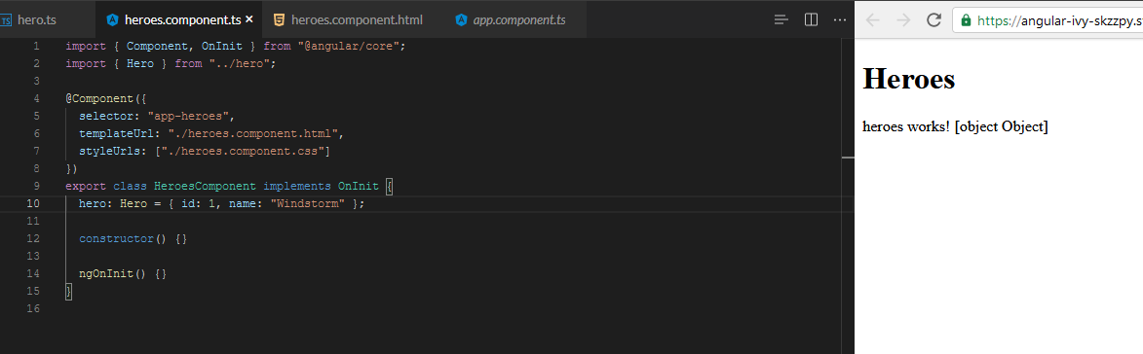
Αποτέλεσμα…: [object]
Λάθος γιατί είναι από string → object
Notes:
hero: Hero = { id: 1, name: 'Windstorm' };

Slide 22
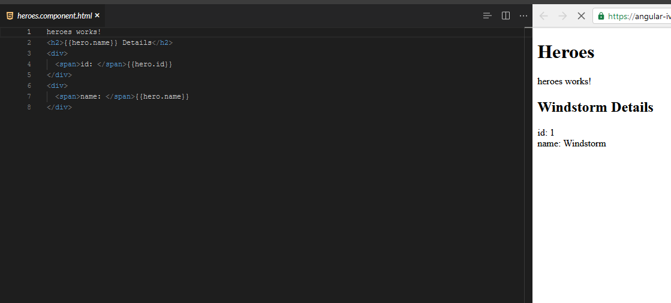
HeroesComponent's template
heroes.component.html
<h2>{{hero.name}} Details</h2>
<div>
<span>id: </span>{{hero.id}}
</div> <div>
<span>name: </span>{{hero.name}}
</div>
heroes.component.html PIPES
<h2>{{hero.name | uppercase}} Details</h2>

Slide 23
Edit
Users should be able to edit the hero name in an <input> textbox.
The textbox should both display the hero's name property and update that property as the user types.
That means data flows from the component class out to the screen and from the screen back to the class.

Slide 24
Two-way binding
To automate that data flow, setup a two-way data binding between the <input> form element and the hero.name property.
[(ngModel)] is Angular's two-way data binding syntax.
src/app/heroes/heroes.component.html (HeroesComponent's template)
<div>
<label>name: <input [(ngModel)]="hero.name" placeholder="name"/>
</label>
</div>
Notes:
AppModule

Slide 25
Two-way binding
Here it binds the
hero.name property to the
HTML textbox
data can flow in both directions: from the hero.name property to the textbox, and from the textbox back to the hero.name.
[(ngModel)] is Angular's two-way data binding syntax.
<div>
<label>name: <input [(ngModel)]="hero.name" placeholder="name"/>
</label>
</div>
… FormsModule
Notes:
… FormsModule

Slide 26
FormsModule
The Angular CLI generated an AppModule class in src/app/app.module.ts when it created the project. This is where you opt-in to the FormsModule.
app.module.ts (FormsModule symbol import)
import { FormsModule } from '@angular/forms'; // <-- NgModel lives here
Then add FormsModule to the @NgModule metadata's imports array, which contains a list of external modules that the app needs.

Slide 27
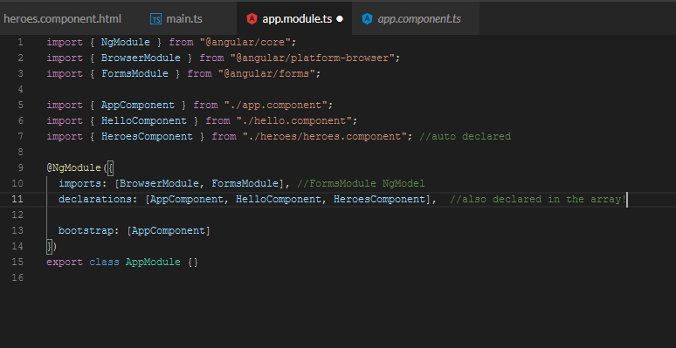
Declare HeroesComponent
Every component must be declared in exactly one NgModule.
Angular CLI declared HeroesComponent in the AppModule when it generated that component.
Open src/app/app.module.ts and find HeroesComponent imported near the top.
import { HeroesComponent } from './heroes/heroes.component';
The HeroesComponent is declared in the @NgModule.declarations array.

Slide 28
Ως εδώ…
CLI to create a second HeroesComponent.
Displayed the HeroesComponent by adding it to the AppComponent shell.
UppercasePipe to format the name.
Two-way data binding with the ngModel directive.
AppModule.
Imported the FormsModule in the AppModule so that Angular would recognize and apply the ngModel directive.
Declaring components in the AppModule and appreciated that the CLI declared it for you.

Slide 29
Display a selection list
Create a file called mock-heroes.ts
src/app/ folder.
Define a HEROES constant as an array of ten heroes
export it.
src/app/mock-heroes.ts
import { Hero } from './hero'; export const HEROES: Hero[] = [
{ id: 11, name: 'Dr Nice' },
{ id: 12, name: 'Narco' },
{ id: 13, name: 'Bombasto' },
{ id: 14, name: 'Celeritas' },
{ id: 15, name: 'Magneta' },
{ id: 16, name: 'RubberMan' },
{ id: 17, name: 'Dynama' },
{ id: 18, name: 'Dr IQ' },
{ id: 19, name: 'Magma' },
{ id: 20, name: 'Tornado' }
];

Slide 30
Displaying heroes
src/app/heroes/heroes.component.ts
(import HEROES)
import { HEROES } from '../mock-heroes';

Slide 31
List heroes with *ngFor
heroes.component.html (heroes template)
<h2>My Heroes</h2>
<ul class="heroes">
<li>
<span class="badge">{{hero.id}}</span> {{hero.name}}
</li>
</ul>
Notes:
1 hero is shown

Slide 32
List heroes with *ngFor
<li *ngFor="let hero of heroes">
The *ngFor is Angular's repeater directive. It repeats the host element for each element in a list.
The syntax in this example is as follows:
<li> is the host element.
heroes holds the mock heroes list from the HeroesComponent class, the mock heroes list.
hero holds the current hero object for each iteration through the list.
Don't forget the asterisk (*) in front of ngFor.

Slide 33
css
src/styles.css (excerpt)
/* Application-wide Styles */
h1 { color: #369; font-family: Arial, Helvetica, sans-serif; font-size: 250%; } h2, h3 { color: #444; font-family: Arial, Helvetica, sans-serif; font-weight: lighter; } body { margin: 2em; } body, input[type="text"], button { color: #333; font-family: Cambria, Georgia; } /* everywhere else */ * { font-family: Arial, Helvetica, sans-serif; }

Slide 34
CSS per component
You may prefer instead to define private styles for a specific component and keep everything a component needs— the code, the HTML, and the CSS —together in one place.
You define private styles either inline in the @Component.styles array or
as stylesheet file(s) identified in the @Component.styleUrls array.

Slide 35
HeroesComponent's private CSS styles
/* HeroesComponent's private CSS styles */
.heroes {
margin: 0 0 2em 0;
list-style-type: none;
padding: 0;
width: 15em;
}
.heroes li {
cursor: pointer;
position: relative;
left: 0;
background-color: #EEE;
margin: .5em;
padding: .3em 0;
height: 1.6em;
border-radius: 4px;
}
.heroes li:hover {
color: #607D8B;
background-color: #DDD;
left: .1em;
}
.heroes li.selected {
background-color: #CFD8DC;
color: white;
}
.heroes li.selected:hover {
background-color: #BBD8DC;
color: white;
}
.heroes .badge {
display: inline-block;
font-size: small;
color: white;
padding: 0.8em 0.7em 0 0.7em;
background-color:#405061;
line-height: 1em;
position: relative;
left: -1px;
top: -4px;
height: 1.8em;
margin-right: .8em;
border-radius: 4px 0 0 4px;
}

Slide 36
Click Event
Master/Detail
When the user clicks a hero in the master list, the component should display the selected hero's details at the bottom of the page.
Listen for the hero item click event and
update the hero detail.

Slide 37
Click Event (2)
The parentheses around click tell Angular to listen for the <li> element's click event. When the user clicks in the <li>, Angular executes the onSelect(hero) expression.
heroes.component.html (template excerpt)
<li *ngFor="let hero of heroes" (click)="onSelect(hero)">
define an onSelect() method in HeroesComponent

Slide 38
On Select
define an onSelect() method in HeroesComponent
src/app/heroes/heroes.component.ts (onSelect)
selectedHero: Hero;
onSelect(hero: Hero): void {
this.selectedHero = hero; }
Notes:
Η σελίδα ξαναλειτουργεί γιατί βρίσκει το onSelect

Slide 39
Add a details section
To click on a hero on the list and reveal details about that hero
heroes.component.html (selected hero details)
<h2>{{selectedHero.name | uppercase}} Details</h2>
<div><span>id: </span>{{selectedHero.id}}</div>
<div> <label>name: <input [(ngModel)]="selectedHero.name" placeholder="name"/> </label> </div>

Slide 40
fix - hide empty details with *ngIf
Μόλις το βάλεις δε παίζει γιατί δεν υπάρχει selectedHero
<div *ngIf="selectedHero">
….
</div>

Slide 41
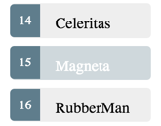
Style the selected hero
.selected CSS class
You just have to apply the .selected class to the <li> when the user clicks it.
The Angular class binding makes it easy to add and remove a CSS class conditionally.
[class.some-css-class]="some-condition" to the element you want to style.

Slide 42
[class.some-css-class]="some-condition"
Add the following [class.selected] binding to the <li> in the HeroesComponent template:
heroes.component.html (toggle the 'selected' CSS class)
[class.selected]="hero === selectedHero“
<li *ngFor="let hero of heroes" [class.selected]="hero === selectedHero" (click)="onSelect(hero)">
<span class="badge">{{hero.id}}</span> {{hero.name}} </li>
Notes:
Αντικαταστήστε το li *ngfor me
<li *ngFor="let hero of heroes" [class.selected]="hero === selectedHero" (click)="onSelect(hero)">

Slide 43
Ως εδώ…
The Tour of Heroes app displays a list of heroes in a Master/Detail view.
The user can select a hero and see that hero's details.
You used *ngFor to display a list.
You used *ngIf to conditionally include or exclude a block of HTML.
You can toggle a CSS style class with a class binding.

Slide 44
Feature Component
moving the hero details into a separate, reusable HeroDetailComponent.
ng generate component hero-detail
Creates a directory src/app/hero-detail.

Slide 45
Copy selectedHero & Rename Hero
replace "selectedHero" with "hero" everywhere in the template
Error in src/app/hero-detail/hero-detail.component.html (1:13)
Property 'hero' does not exist on type 'HeroDetailComponent'.
Notes:
src/app/hero-detail/hero-detail.component.html
<div *ngIf="hero"> <h2>{{hero.name | uppercase}} Details</h2> <div><span>id: </span>{{hero.id}}</div> <div> <label>name: <input [(ngModel)]="hero.name" placeholder="name"/> </label> </div> </div>

Slide 46
The HeroDetailComponent template binds to the component's hero property which is of type Hero.
src/app/hero-detail/hero-detail.component.ts (import Hero)
import { Hero } from '../hero';

Slide 47
Add the @Input() hero property
hero property must be an Input property, annotated with the @Input() decorator, because the external HeroesComponent will bind to it like this.
src/app/hero-detail/hero-detail.component.ts (import Input)
import { Component, OnInit, Input } from '@angular/core';
…
OnInit {….
@Input() hero: Hero;
}

Slide 48
HeroDetailComponent
That's the only change you should make to the HeroDetailComponent class.
There are no more properties.
There's no presentation logic.
This component simply receives a hero object through its hero property and displays it.

Slide 49
Show the HeroDetailComponent
Don’t change the HeroesComponent class
change its template.
heroes.component.html (HeroDetail binding)
<app-hero-detail [hero]="selectedHero"></app-hero-detail>
[hero]="selectedHero" is an Angular property binding.
one way data binding from the selectedHero property of the HeroesComponent to the hero property of the target element, which maps to the hero property of the HeroDetailComponent.

Slide 50
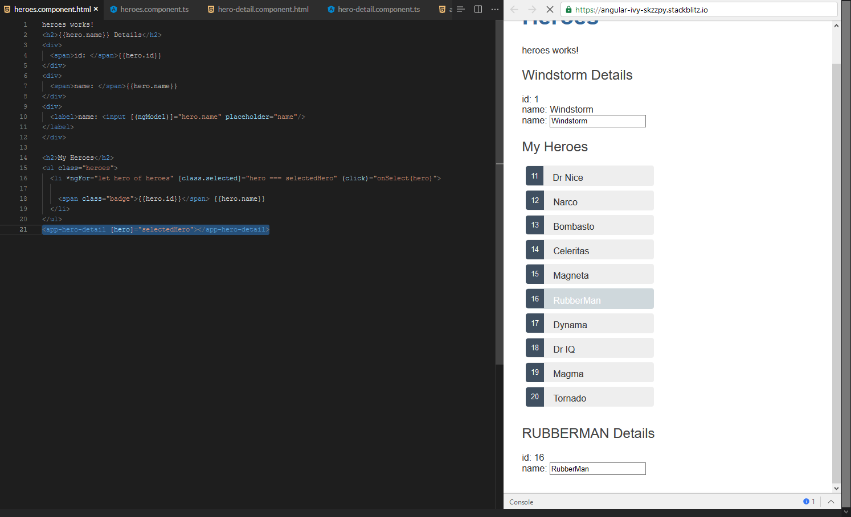

Slide 51
Ως εδώ…
separate, reusable HeroDetailComponent.
property binding to give the parent HeroesComponent control over the child HeroDetailComponent.
@Input decorator to make the hero property available for binding by the external HeroesComponent.

Slide 52
Services!
The Tour of Heroes HeroesComponent is currently getting and displaying fake data.
Components shouldn't fetch or save data directly and they certainly shouldn't knowingly present fake data.
They should focus on presenting data and delegate data access to a service.

Slide 53
Service
HeroService that all application classes can use to get heroes.
Instead of creating that service with the new keyword
Angular dependency injection to inject it into the HeroesComponent constructor.

Slide 54
Share Information
Services are a great way to share information among classes that don't know each other.
You'll create a MessageService and inject it in two places.
Inject in HeroService, which uses the service to send a message.
Inject in MessagesComponent, which displays that message, and also displays the ID when the user clicks a hero.
ng generate service hero

Slide 55
hero.service.ts
import { Injectable } from '@angular/core'; @Injectable({ providedIn: 'root', })
export class HeroService { constructor() { } }
@Injectable → participates in the dependency injection system
The @Injectable() decorator accepts a metadata object for the service, the same way the @Component() decorator did for your component classes.

Slide 56
HeroService
Get hero data from anywhere—a web service, local storage, or a mock data source.
Removing data access from components means you can change your mind about the implementation anytime, without touching any components.
They don't know how the service works.

Slide 57
src/app/hero.service.ts
src/app/hero.service.ts
@Injectable({ providedIn: 'root', }) //single instance
import { Hero } from './hero';
import { HEROES } from './mock-heroes';
getHeroes(): Hero[] { return HEROES; } //return the mock heroes.

Slide 58
Update HeroesComponent
src/app/heroes/heroes.component.ts (import HeroService)
import { HeroService } from '../hero.service';
heroes: Hero[];

Slide 59
Inject the HeroService
Add a private heroService parameter of type HeroService to the constructor.
src/app/heroes/heroes.component.ts
constructor(private heroService: HeroService) {}

Slide 60
Call it in ngOnInit()
Create a method to retrieve the heroes from the service.
getHeroes(): void { this.heroes = this.heroService.getHeroes(); }
While you could call getHeroes() in the constructor, that's not the best practice.
ngOnInit() { this.getHeroes(); }
Notes:
Η σελίδα λειτουργεί πλέον

Slide 61
Observable data
HeroService.getHeroes() synchronous signature
This will not work in a real app.
Προετοιμασία για πραγματικό GET Request που επιστρέφει Observable
Observable is one of the key classes in the RxJS library

Slide 62
src/app/hero.service.ts
src/app/hero.service.ts (Observable imports)
import { Observable, of } from 'rxjs';
getHeroes(): Observable<Hero[]> {
return of(HEROES); }
returns an Observable<Hero[]>
a single value, the array of mock heroes.
Notes:
call HttpClient.get<Hero[]>() which also returns an Observable<Hero[]>

Slide 63
Subscribe in HeroesComponent
The HeroService.getHeroes method used to return a Hero[]. Now it returns an Observable<Hero[]>.
You'll have to adjust to that difference in HeroesComponent.
heroes.component.ts (Observable)
getHeroes(): void { this.heroService.getHeroes() .subscribe(heroes => this.heroes = heroes); }

Slide 64
Subscribe
Observable.subscribe() is the critical difference.
The new version waits for the Observable to emit the array of heroes—which could happen now or several minutes from now.
The subscribe() method passes the emitted array to the callback, which sets the component's heroes property.
This asynchronous approach will work when the HeroService requests heroes from the server.

Slide 65
Show messages
adding a MessagesComponent that displays app messages at the bottom of the screen
creating an injectable, app-wide MessageService for sending messages to be displayed
injecting MessageService into the HeroService
displaying a message when HeroService fetches heroes successfully

Slide 66
MessagesComponent
ng generate component messages
src/app/app.component.html <h1>{{title}}</h1>
<app-heroes></app-heroes>
<app-messages></app-messages>

Slide 67
MessageService
ng generate service message
src/app/message.service.ts
import { Injectable } from '@angular/core';
@Injectable({ providedIn: 'root', })
export class MessageService {
messages: string[] = [];
add(message: string) { this.messages.push(message); }
clear() { this.messages = []; } }

Slide 68
MessageService
The service exposes its cache of messages and two methods:
add() a message to the cache
clear() the cache.

Slide 69
Inject it into the HeroService
src/app/hero.service.ts (import MessageService)
import { MessageService } from './message.service';
constructor(private messageService: MessageService) { }
This is a typical "service-in-service" scenario:
inject the MessageService into the HeroService which is injected into the HeroesComponent.

Slide 70
Send a message from HeroService
Modify the getHeroes() method to send a message when the heroes are fetched.
src/app/hero.service.ts
getHeroes(): Observable<Hero[]> {
// TODO: send the message _after_ fetching the heroes
this.messageService.add('HeroService: fetched heroes');
return of(HEROES); }

Slide 71
Display the message from HeroService
The MessagesComponent should display all messages, including the message sent by the HeroService when it fetches heroes.
src/app/messages/messages.component.ts (import MessageService)
import { MessageService } from '../message.service';
constructor(public messageService: MessageService) {}
Angular only binds to public component properties.

Slide 72
Bind to the MessageService
src/app/messages/messages.component.html
<div *ngIf="messageService.messages.length"> <h2>Messages</h2>
<button class="clear" (click)="messageService.clear()">clear</button>
<div *ngFor='let message of messageService.messages'> {{message}} </div> </div>

Slide 73
binds directly to the component's messageService.
The *ngIf only displays the messages area if there are messages to show.
An *ngFor presents the list of messages in repeated <div> elements.
An Angular event binding binds the button's click event to MessageService.clear().
Βελτιώνεται με CSS
Notes:
/* MessagesComponent's private CSS styles */
h2 { color: red; font-family: Arial, Helvetica, sans-serif; font-weight: lighter; } body { margin: 2em; } body, input[text], button { color: crimson; font-family: Cambria, Georgia; } button.clear { font-family: Arial; background-color: #eee; border: none; padding: 5px 10px; border-radius: 4px; cursor: pointer; cursor: hand; } button:hover { background-color: #cfd8dc; } button:disabled { background-color: #eee; color: #aaa; cursor: auto; } button.clear { color: #333; margin-bottom: 12px; }

Slide 74
Click messages
how to send and display a message each time the user clicks on a hero, showing a history of the user's selections

Slide 75
Click Messages
src/app/heroes/heroes.component.ts
import { Component, OnInit } from '@angular/core';
import { Hero } from '../hero';
import { HeroService } from '../hero.service';
import { MessageService } from '../message.service';
@Component({ selector: 'app-heroes', templateUrl: './heroes.component.html', styleUrls: ['./heroes.component.css'] })
export class HeroesComponent implements OnInit { selectedHero: Hero; heroes: Hero[];
constructor(private heroService: HeroService, private messageService: MessageService) { }
ngOnInit() { this.getHeroes(); }
onSelect(hero: Hero): void { this.selectedHero = hero; this.messageService.add(`HeroesComponent: Selected hero id=${hero.id}`); }
getHeroes(): void { this.heroService.getHeroes() .subscribe(heroes => this.heroes = heroes); } }
Προσθέστε ΜΟΝΟ ΤΑ BOLD ή όλοκληρο

Slide 76
Ως εδώ…
Refactored data access to the HeroService class.
HeroService as the provider of its service at the root level so that it can be injected anywhere in the app.
Angular Dependency Injection to inject it into a component.
HeroService get data method an asynchronous signature.
the RxJS Observable library.
You used RxJS of() to return an observable of mock heroes (Observable<Hero[]>).
The component's ngOnInit lifecycle hook calls the HeroService method, not the constructor.
MessageService for loosely-coupled communication between classes!!!
The HeroService injected into a component is created with another injected service, MessageService.

Slide 77
Routing
in-app navigation

Slide 78
AppRoutingModule
the best practice :
load and configure the router in a separate, top-level module that is dedicated to routing and imported by the root AppModule
module class name is AppRoutingModule
app-routing.module.ts (src/app)

Slide 79
app-routing.module.ts
import { NgModule } from '@angular/core';
import { RouterModule, Routes } from '@angular/router';
import { HeroesComponent } from './heroes/heroes.component';
const routes: Routes = [
{ path: 'heroes', component: HeroesComponent }
];
@NgModule({
imports: [RouterModule.forRoot(routes)],
exports: [RouterModule]
})
export class AppRoutingModule { }
Notes:
AppRoutingModule imports RouterModule and Routes so the app can have routing functionality
HeroesComponent somewhere to go once you configure the routes

Slide 80
Routes
Routes
The next part of the file is where you configure your routes. Routes tell the Router which view to display when a user clicks a link or pastes a URL into the browser address bar.
AppRoutingModule already imports HeroesComponent ← localhost:303/heroes.

Slide 81
Angular Route
A typical Angular Route has two properties:
path: a string that matches the URL in the browser address bar.
component: the component that the router should create when navigating to this route.

Slide 82
RouterModule.forRoot()
The @NgModule metadata initializes the router and starts it listening for browser location changes.
The following line adds the RouterModule to the AppRoutingModule imports array and configures it with the routes in one step by calling RouterModule.forRoot():
imports: [ RouterModule.forRoot(routes) ],
Next, AppRoutingModule exports RouterModule so it will be available throughout the app.
exports: [RouterModule]
Notes:
The method is called forRoot() because you configure the router at the application's root level. The forRoot() method supplies the service providers and directives needed for routing, and performs the initial navigation based on the current browser URL.

Slide 83
Register in app.module.ts
Register in app.module.ts the app-routing.module.ts
import { AppRoutingModule } from "./app-routing.module";
imports: [AppRoutingModule, BrowserModule, FormsModule],

Slide 84
Add RouterOutlet
Αντικατάσταση του <app-heroes></app-heroes>
src/app/app.component.html (router-outlet)
<h1>{{title}}</h1>
<router-outlet></router-outlet>
<app-messages></app-messages>
The AppComponent template no longer needs <app-heroes> because the app will only display the HeroesComponent when the user navigates to it.
Notes:
Tour of Heroes

Slide 85
Add a navigation link (routerLink)
The routerLink is the selector for the RouterLink directive that turns user clicks into router navigations.
It's another of the public directives in the RouterModule.

Slide 86
App.component.css
beautify

Slide 87
dashboard component
<h3>Top Heroes</h3>
<div class="grid grid-pad">
<a *ngFor="let hero of heroes" class="col-1-4">
<div class="module hero">
<h4>{{hero.name}}</h4>
</div>
</a>
</div>

Slide 88
dashboard component
import { Component, OnInit } from '@angular/core';
import { Hero } from '../hero';
import { HeroService } from '../hero.service';
@Component({
selector: 'app-dashboard',
templateUrl: './dashboard.component.html',
styleUrls: [ './dashboard.component.css' ]
})
export class DashboardComponent implements OnInit {
heroes: Hero[] = [];
constructor(private heroService: HeroService) { }
ngOnInit() {
this.getHeroes();
}
getHeroes(): void {
this.heroService.getHeroes()
.subscribe(heroes => this.heroes = heroes.slice(1, 5));
}
}

Slide 89
dashboard component
Δημιουργία dashboard component
CSS
/* DashboardComponent's private CSS styles */
[class*='col-'] {
float: left;
padding-right: 20px;
padding-bottom: 20px;
}
[class*='col-']:last-of-type {
padding-right: 0;
}
a {
text-decoration: none;
}
*, *:after, *:before {
-webkit-box-sizing: border-box;
-moz-box-sizing: border-box;
box-sizing: border-box;
}
h3 {
text-align: center;
margin-bottom: 0;
}
h4 {
position: relative;
}
.grid {
margin: 0;
}
.col-1-4 {
width: 25%;
}
.module {
padding: 20px;
text-align: center;
color: #eee;
max-height: 120px;
min-width: 120px;
background-color: #3f525c;
border-radius: 2px;
}
.module:hover {
background-color: #eee;
cursor: pointer;
color: #607d8b;
}
.grid-pad {
padding: 10px 0;
}
.grid-pad > [class*='col-']:last-of-type {
padding-right: 20px;
}
@media (max-width: 600px) {
.module {
font-size: 10px;
max-height: 75px; }
}
@media (max-width: 1024px) {
.grid {
margin: 0;
}
.module {
min-width: 60px;
}
}

Slide 90
dashboard
The template presents a grid of hero name links.
The *ngFor repeater creates as many links as are in the component's heroes array.
The links are styled as colored blocks by the dashboard.component.css.
The links don't go anywhere yet but they will shortly.
The class is similar to the HeroesComponent class.
It defines a heroes array property.
The constructor expects Angular to inject the HeroService into a private heroService property.
The ngOnInit() lifecycle hook calls getHeroes().

Slide 91
dashboard
.subscribe(heroes => this.heroes = heroes.slice(1, 5));
This getHeroes() returns the sliced list of heroes at positions 1 and 5, returning only four of the Top Heroes (2nd, 3rd, 4th, and 5th).

Slide 92
Add the dashboard route
src/app/app-routing.module.ts (import DashboardComponent)
import { DashboardComponent } from './dashboard/dashboard.component’;
….
{ path: 'dashboard', component: DashboardComponent },
Notes:
const routes: Routes = [
{ path: "heroes", component: HeroesComponent },
{ path: "dashboard", component: DashboardComponent }
];

Slide 93
Add a default route
This route redirects a URL that fully matches the empty path to the route whose path is '/dashboard'.
src/app/app-routing.module.ts
{ path: '', redirectTo: '/dashboard', pathMatch: 'full' },

Slide 94
Add dashboard link to the shell
src/app/app.component.html
<h1>{{title}}</h1>
<nav>
<a routerLink="/dashboard">Dashboard</a>
<a routerLink="/heroes">Heroes</a>
</nav>
<router-outlet></router-outlet>
<app-messages></app-messages>
ΕΠΙΤΕΛΟΥΣ NAVIGATION!

Slide 95
Navigating to hero details
The user should be able to get to these details in three ways.
By clicking a hero in the dashboard.
By clicking a hero in the heroes list.
By pasting a "deep link" URL into the browser address bar that identifies the hero to display.

Slide 96
Ως εδώ…

Slide 97
Delete hero details from HeroesComponent
Open the HeroesComponent template (heroes/heroes.component.html)
delete the <app-hero-detail> element from the bottom.
Notes:
Clicking a hero item now does nothing!!! (δεν γράφει τα στοιχεία πανω από το μήνυμα)

Slide 98
Add a hero detail route
URL like ~/detail/11 would be a good URL
src/app/app-routing.module.ts
(import HeroDetailComponent)
import { HeroDetailComponent } from './hero-detail/hero-detail.component’;
…
{ path: 'detail/:id', component: HeroDetailComponent },
The colon (:) in the path indicates that :id is a placeholder for a specific hero id.
Notes:
The colon (:) in the path indicates that :id is a placeholder for a specific hero id.

Slide 99
DashboardComponent hero links
src/app/dashboard/dashboard.component.html (hero links)
<a *ngFor="let hero of heroes" class="col-1-4"
routerLink="/detail/{{hero.id}}">
<div class="module hero">
<h4>{{hero.name}}</h4>
</div>
</a>

Slide 100
HeroesComponent hero links
src/app/heroes/heroes.component.html (list with onSelect)
<ul class="heroes">
<li *ngFor="let hero of heroes"
[class.selected]="hero === selectedHero"
(click)="onSelect(hero)">
<span class="badge">{{hero.id}}</span> {{hero.name}}
</li>
</ul>

Slide 101
Strip the li
src/app/heroes/heroes.component.html (list with links)
<ul class="heroes"> <li *ngFor="let hero of heroes"> <a routerLink="/detail/{{hero.id}}"> <span class="badge">{{hero.id}}</span> {{hero.name}} </a> </li> </ul>

